Slide 1
Digital Portfolio
STUDENT NAME: KAVIPRIYA.P
REGISTER NO AND NMID: asunm1451222407494
DEPARTMENT: B.Sc., Computer Science
COLLEGE: Mahalashmi women’s college of arts and science.

Slide 2
PROJECT TITLE
Digital Portfolio

Slide 3


AGENDA
Problem Statement
Project Overview
End Users
Tools and Technologies
Portfolio design and Layout
Features and Functionality
Results and Screenshots
Conclusion
Github Link
3/21/2024 Annual Review

Slide 4

PROBLEM STATEMENT
In today’s fast-growing digital world, resumes alone are not enough to highlight skills and achievements. Many students and professionals find it difficult to present their projects in an engaging way. Traditional formats fail to capture creativity, interactivity, and real abilities. Employers now expect modern and accessible ways to view talent. A digital portfolio provides the perfect platform to showcase work effectively

Slide 5

PROJECT OVERVIEW
A digital portfolio to present skills, projects, and achievements.
Built with HTML, CSS, and JavaScript for a modern look.
Includes sections: About Me, Skills, Projects, and Contact.

Slide 6

WHO ARE THE END USERS?
Students & Freshers – to showcase skills and projects.
Professionals – to build a strong digital presence.
Employers/Recruiters – to evaluate candidate’s abilities easily.

Slide 7

TOOLS AND TECHNIQUES
HTML, CSS, JavaScript – for structure, styling, and interactivity.
CodePen / VS Code – for coding and testing.
Responsive Design – ensures mobile and desktop compatibility.

Slide 8
POTFOLIO DESIGN AND LAYOUT
Home Section – Introduction with profile image and title.
About Me – Personal details and background.
Skills – Highlighting technical and soft skills.
Projects – Showcasing completed works.
Contact – Form and details for communication.
8

Slide 9
FEATURES AND FUNCTIONALITY
Interactive Navigation – Easy access to all sections.
Responsive Design – Works on mobile, tablet, and desktop.
Contact Form – For communication with visitors.
Skills & Projects Showcase – Displays abilities in a structured way.
Personal Branding – Builds a strong digital identity.

Slide 10
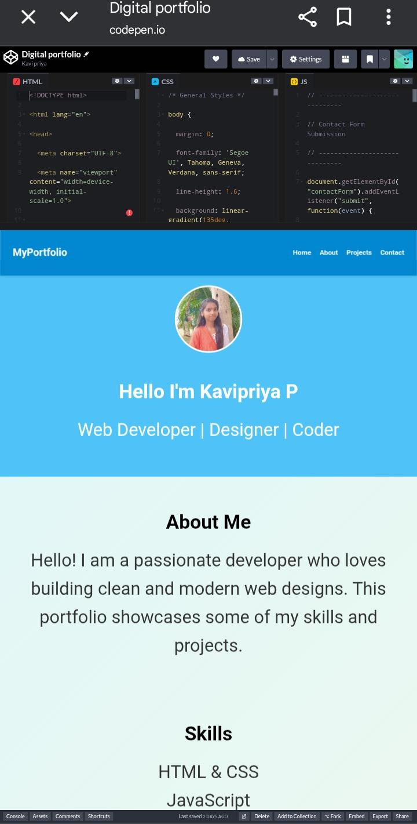

RESULTS AND SCREENSHOTS
Successfully showcased skills, projects, and achievements.
3/21/2024 Annual Review
10

Slide 11
CONCLUSION
Project goals achieved
Portfolio is interactive & responsive.
Useful for showcasing skills.
11

